Slide 1

Operation Hermes
Team 6 – CSC 439 – 001

Slide 2
Meet Team 6
Participant | Roles | Skills
Kinslow, Johnathan (Johnny) | Team Leader / Developer | C, C++, C#, HTML, CSS, PHP, JavaScript, Python, Java, SQL
Peace, Spencer | Build Manager / Developer | C, C#, Java, Ruby, Python, SQL, PHP
Le, Thanh Tung (Le) | Tester / Debugger / Developer | html, CSS, Javascript, Java, PHP, SQL, C++
LeDonne, McKenzie (Kenzie) | Project Manager / Developer | C, C++, HTML, CSS, SQL, Java
Minks, Austin (AJ) | Configuration Manager / Developer | C, C++, Java, SQL, html, css, php, python
Salazar, Jose | Version Control Manager / Developer | Java, Python, SQL, Html, CSS, JavaScript, Ruby, PHP, Angular, Git, Power BI, AWS, Google Cloud.
29/01/20

Slide 3
Operation Hermes:
Operation Hermes is a development project working to streamline the ever increasing amount of online shopping that is bogging down warehouse management systems.
With Operation Hermes, we plan to:
Create an easier and more affordable way to manage incoming goods
Manage the current inventory of a warehouse
Use a similar approach to the incoming goods to also manage outgoing goods
Track the amount of goods that are coming and going to show popularity of items
Create a system that allows for the deployment throughout all facilities with stored data centers for trend accuracy
29/01/20

Slide 4
Team Structure
Team 6 will be using an Agile development methodology
Setup:
Sprint length will be 2 week sections
Total development time will be 16 weeks
Meetings are to occur at every sprint start or when needed
System stability is of key concern, so focus on that will be key to meeting agenda
29/01/20

Slide 5

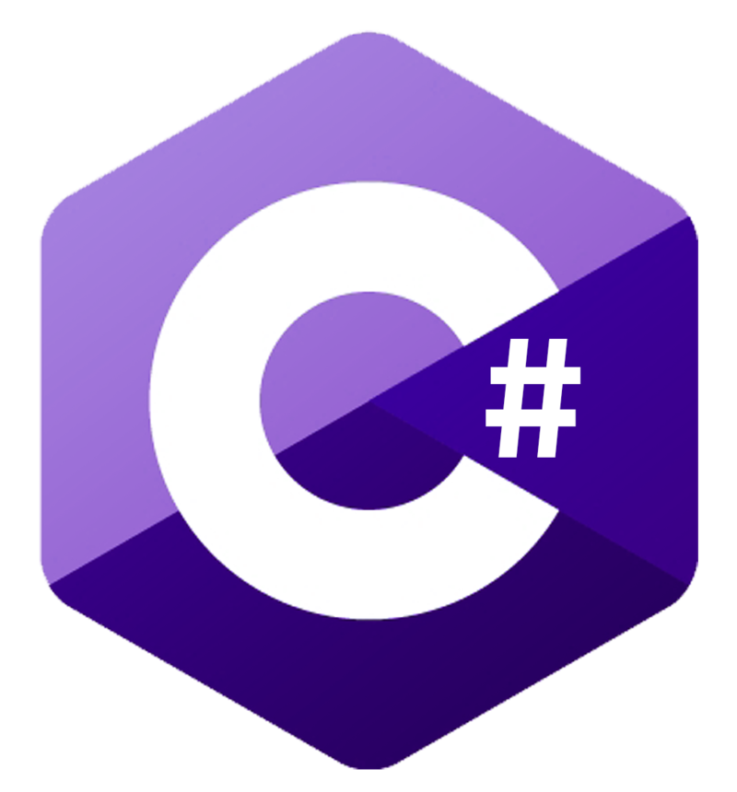
Tech Stack
As we want our web app to be light and responsive, we’ve chosen the following technologies to build this project:
Frontend:
Vue.js
80 KB library size- Lightweight!
High customizability- Easy for our frontend devs to learn!
Integration with Bootstrap
Backend:
C# and ASP.NET
Familiarity- Our backend devs are fluent with C# and ASP.NET
Powerful Libraries- ASP.NET has robust libraries available for our use
Language independent- Works well with frontend frameworks

Slide 6


Testing Approach
For testing, we will need several frontend and backend tools and methodologies.
The following is a brief list of ideas we have thus far:
Frontend:
Vue.js has built-in unit tests available for our use
Jest package (delightful JavaScript testing tool)
Supports snapshot tests can be written faster than traditional ones
Backend:
Postman (used to test the response of API calls)
Manually querying the database to check validity of data via software like SQL Server Management Studio

Slide 7

Version Control
Team 6 would be using GitHub since it is a platform-agnostic Version Control software.
Structure:
2 branches: Production, and Develop.
New features would be implemented and tested in the Develop branch.
Once unit tests pass, Develop would be merged into Production for deployment.
Linux users manage their implementation and merges via Console.
Windows users use the GitHub GUI.
Mac users use either the GitHub GUI, or the Command Line.

Slide 8
Test Level's
Progress through the Project will be monitored by a “Ring System” The Ring system will be where testing will either prove a pass or fail, and if there are no major issues, and less than 2 minor issues, then the program goes into the next ring segment.
There are 4 “rings” we will be working through, Alpha, Beta, Post Production, and Release
29/01/20

Slide 9
Testing Characteristics
Input:
Text document ran through a scanning system to strip data to a readable format
Digital documents of a predetermined format
(Future Feature) Implementation of Google Lens support for visual verification
Output:
Updated counts of current warehouse stock
Graphs showing the increase / decrease of goods in the warehouse per truck
Create documents showing the daily incoming and outgoing goods according to records.
29/01/20

Slide 10
Test Identification
The testing that will be conducted on the software will be unit testing regularly, and a weekly Integration Test done to ensure stability.
We plan to design some continuous Integration testing programs to run on the process to take care of the weekly tests
29/01/20

Slide 11
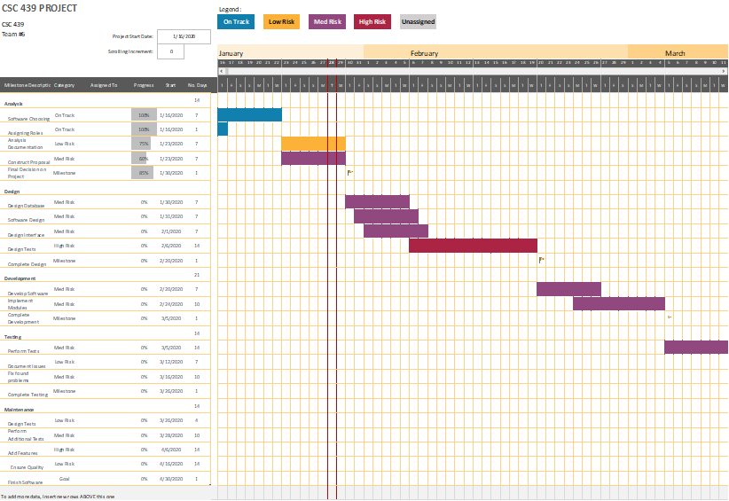
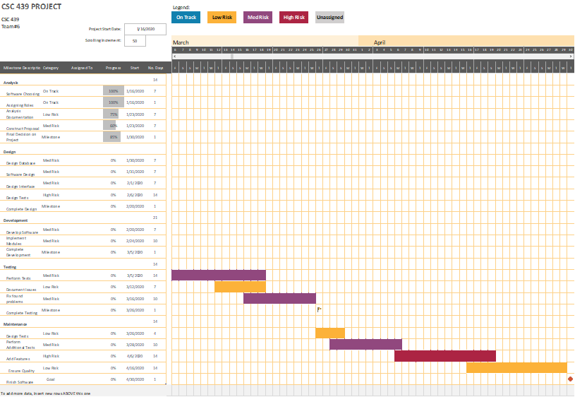
Planned Testing Schedule

Slide 12
Requirements Traceability Matrix
REQ ID | Req Description | Component | Source / Requester | Justification / Need | WBS Deliverable | Test Strategy | Status | Active / Inactive
0
1 | Design and create database for application |  | AJ | plan out an efficient database design |  | Task 1.1 | Waiting | Inactive
2 | Discuss Framework for the Frontend |  | Jose | Decide on framework for team to use for frontend |  | Task 1.2 | Waiting | Inactive
3 | Choose a language for the web app to be written in |  | AJ | Decide on language for web app |  | Task 1.3 | Waiting | Inactive
4 | Creating endpoints in the API |  | Jose | Endpoints are what perform CRUD operations |  | Task 1.4 | Waiting | Inactive
5 | Design and create homepage |  | Spencer | Design homepage that will handle all of the functions |  | Task 1.5 | Waiting | Inactive
6 | Choosing which datapoints to track |  | Spencer | Deciding what we want to track in inventory |  | Task 1.6 | Waiting | Inactive
7 | Discuss Tech Stack (Front & Back end) |  | Spenncer | Establish a consistent framework |  | Task 1.7 | Waiting | Inactive
8 | Create login homepage for admin/users |  | AJ | different privileges for different users |  | Task 1.8 | Waiting | Inactive
9 | Setup project strucure |  | Jose | Put up code scaffolding |  | Task 1.9 | Waiting | Inactive
10
29/01/20

Slide 13
Final Closing Statements
Overall, we’re incredibly excited to begin working on this application and see great potential in its design.
Through this assignment we hope to build the skills required for use in the professional world. We hope to produce a system for use in an environment where there are multiple distributed warehouses with a storage center to contain the data collected by the systems.

